Slide 1
Logistic Regression
Some slides adapted from Dan Jurfasky and Brendan O’Connor

Slide 2
Naïve Bayes Recap
Bag of words (order independent)
Features are assumed independent given class
Q: Is this really true?

Slide 3
The problem with assuming conditional independence
Correlated features -> double counting evidence
Parameters are estimated independently
This can hurt classifier accuracy and calibration

Slide 4
Logistic Regression
(Log) Linear Model – similar to Naïve Bayes
Doesn’t assume features are independent
Correlated features don’t “double count”

Slide 5
What are “Features”?
A feature function, f
Input: Document, D (a string)
Output: Feature Vector, X

Slide 6
What are “Features”?
Doesn’t have to be just “bag of words”

Slide 7
Feature Templates
Typically “feature templates” are used to generate many features at once
For each word:
${w}_count
${w}_lowercase
${w}_with_NOT_before_count

Slide 8
Logistic Regression: Example
Compute Features:
Assume we are given some weights:

Slide 9
Logistic Regression: Example
Compute Features
We are given some weights
Compute the dot product:

Slide 10
Logistic Regression: Example
Compute the dot product:
Compute the logistic function:

Slide 11
The Logistic function

Slide 12
The Dot Product
Intuition: weighted sum of features
All Linear models have this form

Slide 14
Naïve Bayes as a log-linear model
Q: what are the features?
Q: what are the weights?

Slide 15
Naïve Bayes as a Log-Linear Model

Slide 16
Naïve Bayes as a Log-Linear Model
In both Naïve Bayes and Logistic Regression we Compute The Dot Product!

Slide 17
NB vs. LR
Both compute the dot product
NB: sum of log probabilities
LR: logistic function

Slide 18
NB vs. LR: Parameter Learning
Naïve Bayes:
Learn conditional probabilities independently by counting
Logistic Regression:
Learn weights jointly

Slide 19
LR: Learning Weights
Given: a set of feature vectors and labels
Goal: learn the weights

Slide 20
Learning Weights
Feature
Labels
Document

Slide 21
Q: what parameters should we choose?
What is the right value for the weights?
Maximum Likelihood Principle:
Pick the parameters that maximize the probability of the data

Slide 22
Maximum Likelihood Estimation

Slide 23
Maximum Likelihood Estimation

Slide 24
Maximum Likelihood Estimation
Unfortunately there is no closed form solution
(like there was with naïve bayes)
Solution:
Iteratively climb the log-likelihood surface through the derivatives for each weight
Luckily, the derivatives turn out to be nice

Slide 25
Gradient ascent
Loop While not converged:
For all features j, compute and add derivatives
: Training set log-likelihood
: Gradient vector

Slide 26
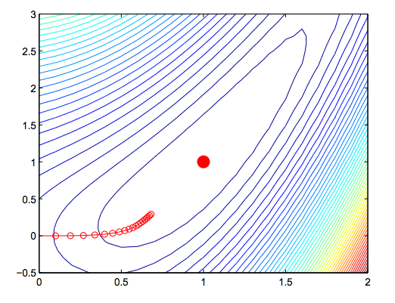
Gradient ascent

Slide 27
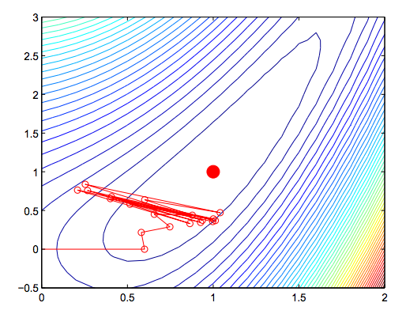
Gradient ascent

Slide 28
LR Gradient

Slide 30
Logistic Regression: Pros and Cons
Doesn’t assume conditional independence of features
Better calibrated probabilities
Can handle highly correlated overlapping features
NB is faster to train, less likely to overfit

Slide 31
NB & LR
Both are linear models
Training is different:
NB: weights are trained independently
LR: weights trained jointly

Slide 32
Perceptron Algorithm
Very similar to logistic regression
Not exactly computing gradients

Slide 33
Perceptron Algorithm
Algorithm is Very similar to logistic regression
Not exactly computing gradients
Initalize weight vector w = 0
Loop for K iterations
Loop For all training examples x_i
if sign(w * x_i) != y_i
w += (y_i - sign(w * x_i)) * x_i

Slide 34
Differences between LR and Perceptron
Online learning vs. Batch
Perceptron doesn’t always make updates

Slide 35
MultiClass Classification
Q: what if we have more than 2 categories?
Sentiment: Positive, Negative, Neutral
Document topics: Sports, Politics, Business, Entertainment, …
Could train a seperate logistic regression model for each category...
Pretty clear what to do with Naive Bayes.

Slide 36
Log-Linear Models

Slide 37
MultiClass Logistic Regression

Slide 38
MultiClass Logistic Regression
Binary logistic regression:
We have one feature vector that matches the size of the vocabulary
Multiclass in practice:
one weight vector for each category
Can represent this in practice with one giant weight vector and repeated features for each category.

Slide 39
Q: How to compute posterior class probabilities for multiclass?

Slide 40
Maximum Likelihood Estimation

Slide 41
Multiclass LR Gradient

Slide 42
MAP-based learning (perceptron)

Slide 43
Online Learning (perceptron)
Rather than making a full pass through the data, compute gradient and update parameters after each training example.

Slide 44
MultiClass Perceptron Algorithm
Initalize weight vector w = 0
Loop for K iterations
Loop For all training examples x_i
y_pred = argmax_y w_y * x_i
if y_pred != y_i
w_y_gold += x_i
w_y_pred -= x_i

Slide 45
Q: what if there are only 2 categories?

Slide 46
Q: what if there are only 2 categories?

Slide 47
Q: what if there are only 2 categories?

Slide 48
Q: what if there are only 2 categories?

Slide 49
Q: what if there are only 2 categories?

Slide 50
Q: what if there are only 2 categories?

Slide 51
Regularization
Combating over fitting
Intuition: don’t let the weights get very large

Slide 52
Regularization in the Perceptron Algorithm
Can’t directly include regularization in gradient
# of iterations
Parameter averaging

